Slide 1
Paper Nine:
English Phonetics and Linguistics
Sound Unit: Features of Connected speech: assimilation, elision and juncture
by
Dr. Prithiviraj Singh Chauhan

Slide 2
Features of Connected Speech : Assimilation
During the pronunciation of words , some phone sounds get affected by the sounds the precede and /or succeed it.
They way in which sounds influence each other is called assimilation.
Example: Peace /p/ aspirated
speed /p/ unaspirated
speed /i:/ long vowel
peace / i./ short

Slide 3
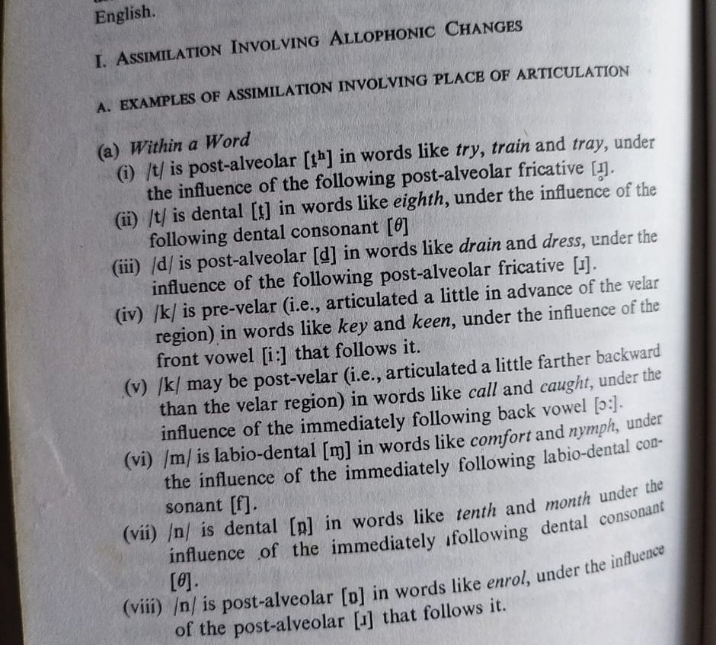
Examples:

Slide 4
Elision:
In order to maintain the characteristic rhythm of English we have to pronounce the unaccented syllables rapidly and, in doing so, certain sounds are elided i.e. omitted while speaking.
For example:
Them /ðem/ In isolation
Them /ðm/ in connected speech

Slide 5
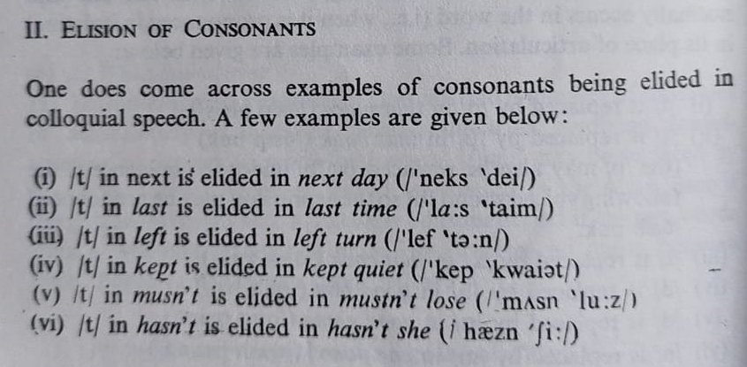
Example:

Slide 6
Juncture:
Juncture: Juncture refers to breaks or pauses in speech that indicate words or other grammatical units.
Phonetic boundaries used to demarcate words or other grammatical units are known as junctures. There are several phrases in English that are distinguishable in this way: “that stuff”/ that’s tough; “an aim”/ “a name." In the first case, for example, the {s} of “stuff” is stronger, and the {t} of tough is aspirated.
Juncture is phonemic, that is it changes the meaning as in the following example: "I scream" and "ice cream. (Douglas Magrath)

Slide 7
Reference:
Balasubramanian, T.(2002) A Textbook of English Phonetics for Indian Students. New Delhi: Macmillan Publication. Rpt.
Douglas Magrath. The theory of language: ESL and phonetics. https://exclusive.multibriefs.com/content/the-theory-of-language-esl-and-phonetics/education Retrieved on 30/08/2020
For more information visit:
https://www.slideshare.net/janeRosieEnomar/presentation-english-17032067

